Slide 1

TVS EMPLOYEE PERFROMANCE AND JOB SATISFATION IN HR ANALYSIS
DASHBOARD
PRESENTATION BY:
PRIYADHARSHINI.K

Slide 2
CONTENTS
TABLE NUMBER | PARTICULARS
1 | INTRODUCTION
2 | PROBLEM STATEMENT
3 | DATASET OVERVIEW
4 | TECHNOLOGY USED AND DATA TRANSFORMATION STEPS
5 | DATA MODELING
6 | KPI SUMMARY
7 | CHARTS USED IN DASHBOARD
8 | THE PROBLEM STATEMENT QUESTIONS WITH EXPLANATIONS
9 | CONCLUSION

Slide 3
INTRODUCTION
HR Analysis – Meaning
HR Analysis (Human Resource Analytics) is the process of collecting, analyzing, and interpreting employee data to make data-driven decisions that improve workforce performance, employee satisfaction, and organizational effectiveness.
In simple terms, HR Analysis helps organizations understand:
Why employees leave (attrition)
How performance varies across roles and departments
What factors affect job satisfaction and productivity
How to plan hiring, training, and retention strategies

Slide 4
Problem Statement
Organizations often struggle to identify the key drivers behind employee attrition, low performance, and job dissatisfaction due to fragmented HR data and limited analytical visibility. The absence of consolidated dashboards makes it difficult to analyze workforce patterns efficiently.
The objective of this project is to analyze HR data to:
Identify factors influencing employee attrition and retrenchment
Understand the relationship between job satisfaction, performance ratings, and experience
Analyze workforce distribution across job levels and distance from workplace
Support HR decision-making through interactive and visual analytics

Slide 5
DATASET OVERVIEW
The dataset used in this project contains employee-level HR information with the following key attributes:
Employee ID
Age and Gender
Department and Job Role
Job Level
Years of Service (Experience)
Job Satisfaction Level
Performance Rating
Distance from Workplace
Retrenchment / Attrition Status
The dataset is structured in tabular format and represents a cross-section of employees across different departments and experience levels.

Slide 6
Technology Used & Data Transformation Steps
Tools & Technologies:
Power BI Desktop
Power Query Editor
DAX (Data Analysis Expressions)
Microsoft Excel (for initial data validation)

Slide 7
Data Transformation Steps:
Imported raw HR dataset into Power BI
Removed duplicate and null records
Standardized column names and data types
Created calculated columns for service year bands and distance categories
Categorized job satisfaction and performance ratings
Ensured data consistency for categorical fields

Slide 8
Data Modeling
A star schema–based data model was implemented to ensure optimal performance and scalability.
Fact Table: Employee HR Data
Dimension Tables:
Department
Job Level
Satisfaction Level
Performance Rating
Relationships were created using unique keys, with appropriate cardinality and filter directions to support accurate analysis.

Slide 9
KPI Summary
The dashboard highlights the following key performance indicators (KPIs):
Total Employees
Active Employees
Attrition / Retrenchment Count
Attrition Rate (%)
Average Job Satisfaction Score
Average Performance Rating
Average Years of Service
These KPIs provide a quick snapshot of overall workforce health.

Slide 10
Charts Used in the Dashboard
The following visualizations were used to present insights effectively:
Bar Chart: Employee count by department and job level
Pie / Donut Chart: Attrition distribution
Column Chart: Performance rating vs job satisfaction
Line Chart: Attrition trend by years of service
Stacked Bar Chart: Job satisfaction by job level
Slicer Controls: Department, job role, gender, retrenchment status
These charts enable interactive analysis and easy drill-down for decision-makers.

Slide 11
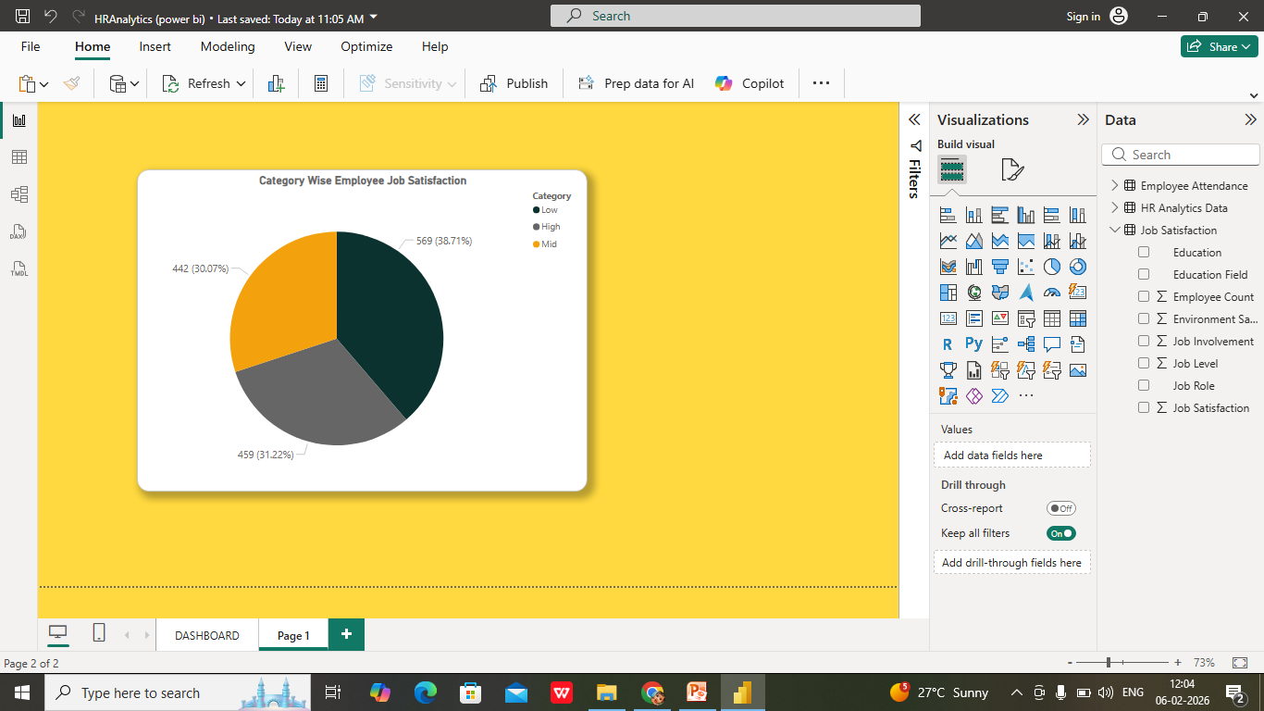
Pie Chart – Category Wise Employee Job Satisfaction
Chart Type: Pie Chart
Categories:
Low
Mid
High
Explanation:
This chart shows the distribution of employees based on job satisfaction levels. Each slice represents the percentage of employees falling under a satisfaction category.

Slide 12
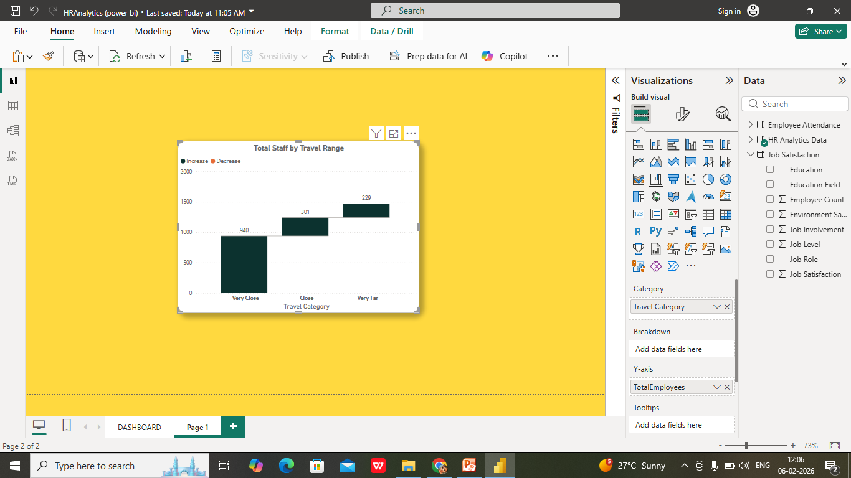
Waterfall Chart – Total Staff by Travel Range
Chart Type: Waterfall Chart
Travel Categories:
Very Close
Close
Very Far
Explanation:
This chart displays the incremental contribution of employees based on business travel distance. It shows how each travel category increases the total employee count.

Slide 13
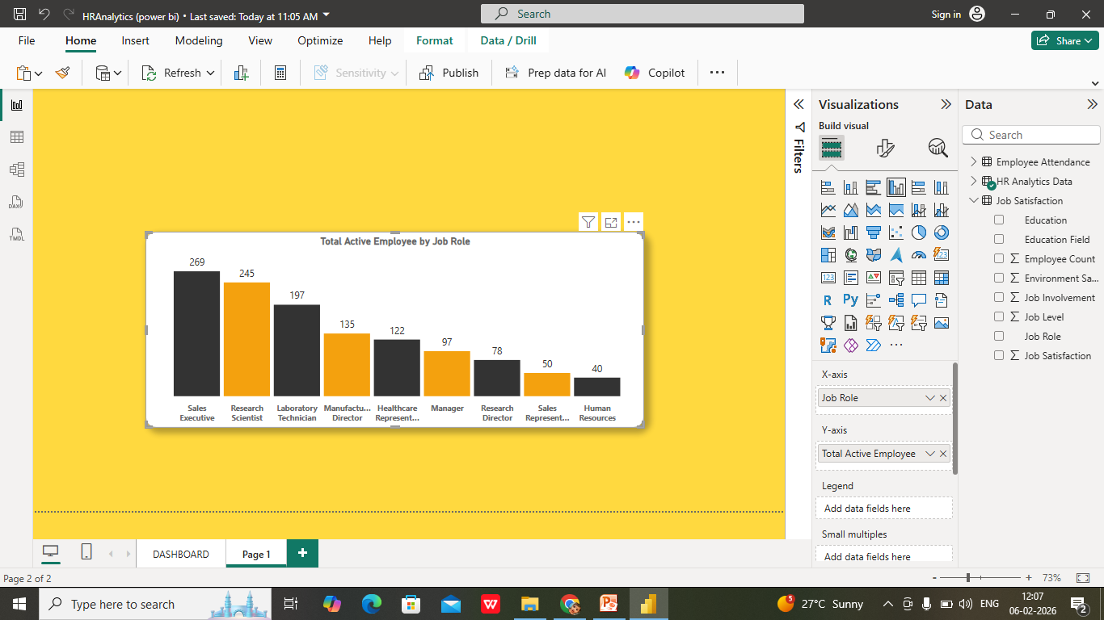
Clustered Column Chart – Total Active Employee by Job Role
Chart Type: Clustered Column Chart
Job Roles Include:
Sales Executive
Research Scientist
Laboratory Technician
Manufacturing Director
Healthcare Representative
Manager
Research Director
Sales Representative
Human Resources
Explanation:
This chart compares the number of active employees across different job roles.

Slide 14
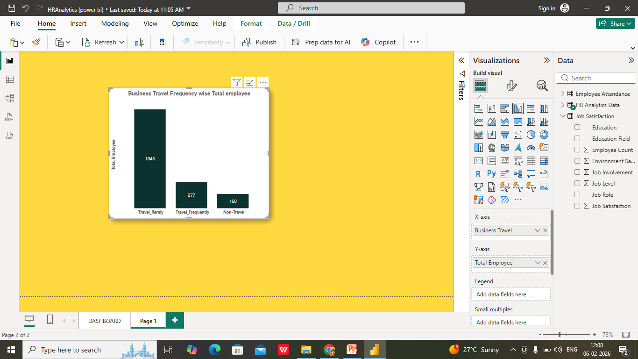
Column Chart – Business Travel Frequency Wise Total Employee
Total Employee
Chart Type: Column Chart
Travel Frequency Categories:
Travel Rarely
Travel Frequently
Non-Travel
Explanation:
Shows how employees are distributed based on how often they travel for business.

Slide 15
THE PROBLEMS SATEMENT QUESTIONS WITH EXPLANATIONS
1.What is the average monthly income of employees?
This question calculates the average monthly income of all employees. It helps understand the organization’s overall salary structure and compensation level.
2. What percentage of employees are not due for promotion?
This identifies the percentage of employees who are currently not eligible for promotion. It helps HR assess workforce readiness for career growth and development.
3. What is the average monthly pay rate?
This measures the average monthly pay rate across employees, helping evaluate pay consistency and fairness within the organization.
4. What percentage of employees are due for promotion?
This shows the proportion of employees eligible for promotion, supporting HR planning for promotions, leadership development, and succession management.

Slide 16
5. What is the average salary hike?
This calculates the average increase in employee salaries over time. It reflects the company’s reward strategy and its impact on employee motivation and retention.
6. What is the environment satisfaction rating out of 5?
This measures how satisfied employees are with their work environment on a scale of 1 to 5. It helps evaluate workplace conditions and employee morale.
7. How many total employees are there in the organization?
This provides the total headcount of employees. It is a key metric for workforce size, planning, and resource allocation.
8. What is the attrition count?
This shows the total number of employees who have left the organization. It helps HR understand employee turnover volume.

Slide 17
9. What is the attrition rate?
This calculates the percentage of employees who left the organization during a specific period.
10. What is the average age of employees?
This determines the average age of the workforce, helping analyze employee demographics and plan future hiring and succession strategies.
11. What is the distribution of employees by job satisfaction category?
This analyzes how employees are distributed across different job satisfaction levels (low, medium, high). It helps identify areas of dissatisfaction that may impact performance or attrition.
12. What is the distribution of employees by travel range?
This shows employee distribution based on travel distance to work. It helps assess whether long commuting distances influence job satisfaction or attrition.

Slide 18
13. What is the distribution of employees by job role?
This analyzes how employees are spread across different job roles. It supports workforce planning and role-based performance analysis.
14. What is the distribution of employees based on business travel frequency?
This shows how often employees travel for work (rarely, frequently, or not at all). It helps understand the impact of business travel on work-life balance and employee retention.

Slide 19
Conclusion
The HR Analytics dashboard provides a comprehensive view of workforce dynamics and highlights critical factors affecting employee performance and retention. By leveraging Power BI and data-driven insights, HR teams can proactively address attrition risks, improve job satisfaction, and optimize workforce planning. This project demonstrates how analytics can transform raw HR data into meaningful insights that support strategic and operational HR decisions.

Slide 20


